Slide 1
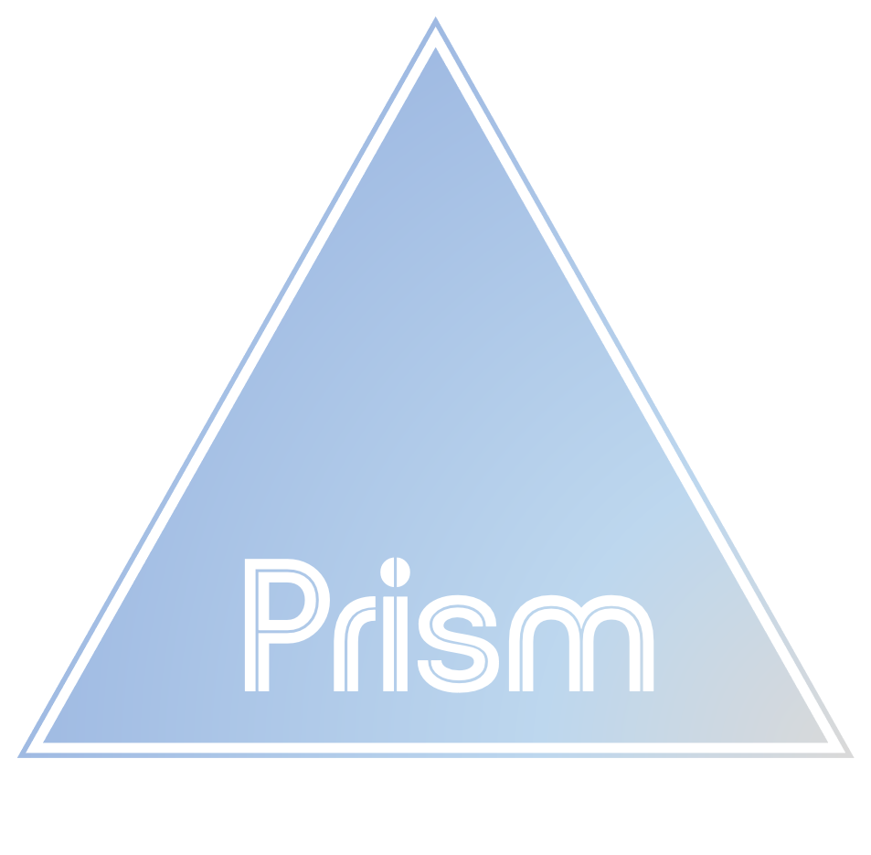
Prism Week One Project: KPI Dashboard
By: Red Group
Notes:
Thank you for joining today. I will present Prism’s KPI dashboard focusing on
two critical KPIs: Revenue and Return on Ad Spend (ROAS

Slide 2
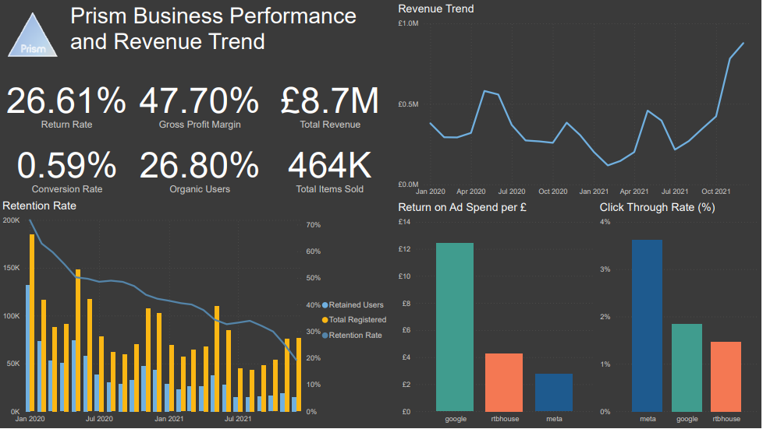
Performance in 2020 & 2021 & trends
Notes:
Here are the performance figures for prism both 2020 and 2021 showing current trends

Slide 3
Executive Summary
Prism has been recently acquired by Quadrangle, a corporation with ambitious growth goals. Prism currently lacks a unified platform to track key performance indicators (KPIs), making it difficult for the management to make data-driven decisions.
Visual: A simple, high-level graph showing the revenue spike in November 2021.
Additional Content: Meta Ads: Underperformed despite high ad spend, needing optimisation for better conversion.
Revenue spike driven by Black Friday.
Google Ads delivering the highest ROAS.
Meta needing optimisation for better conversions.
Recommendation to increase Black Friday ad spend and improve Meta ads.
Notes:
Here’s a summary of our findings and recommendations, which will guide our detailed discussion.
what Prism has done well and what should they change NOTE

Slide 4
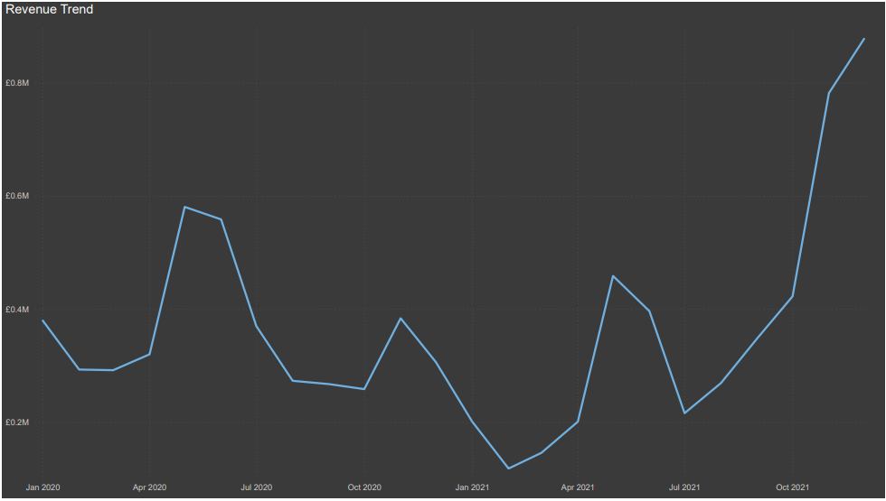
Revenue Spike in Late 2021 Driven by Black Friday
December 2021 saw a sharp increase in revenue, coinciding with Black Friday sales. This seasonal spike indicates strong demand, and replicating it will be crucial for 2022.
Grows over £0.8m during November & December date.

Slide 5
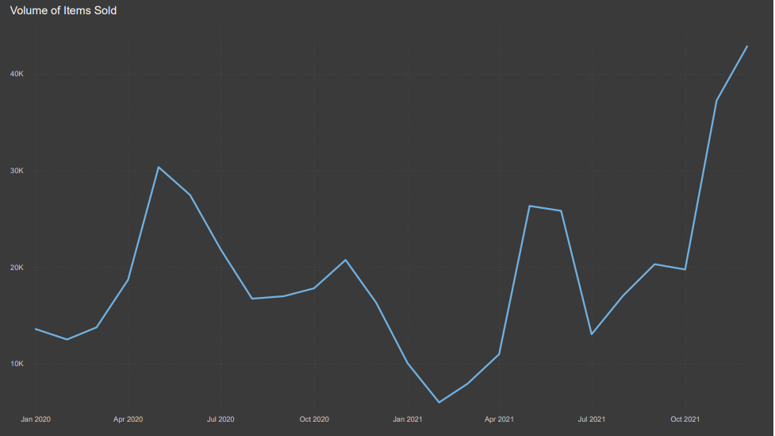
Black Friday Promotion Increased Sales Volume
The highest volume of products sold was during Black Friday, confirming that our seasonal marketing strategy directly drove this spike in revenue.
The next steps include setting up marketing campaigns earlier and refining our ad targeting across platforms
Notes:
The highest volume of products sold was during Black Friday, confirming that our seasonal marketing strategy directly drove this spike in revenue.

Slide 6
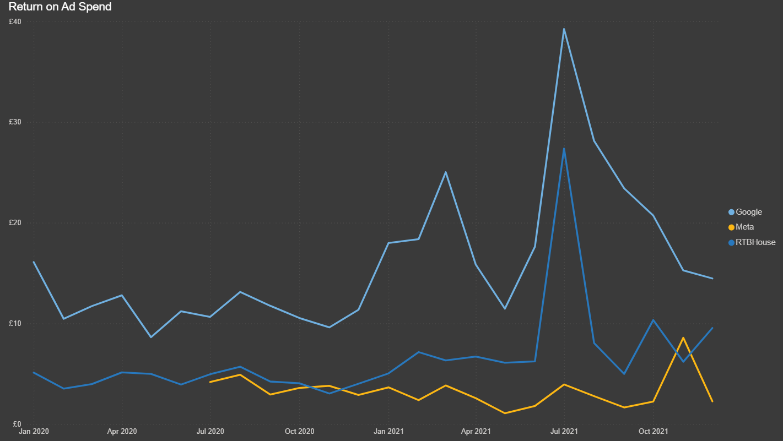
Google Ads Drove Highest ROAS, Meta Requires Optimisation
This chart displays the Return on Ad Spend (ROAS) for Google, Meta, and RTB House, showing that Google consistently outperformed the others during mid-summer.

Slide 7
Actionable Recommendations for Black Friday 2022
Increase Black Friday Marketing Investment
Optimize Google Ads
Introduce Time-Limited Offers
Target social media platform ads
Notes:
Allocate more budget to high-performing channels, especially Google Ads.
Improve targeting and messaging to convert more effectively during peak periods.
Extend Black Friday promotions for a longer duration. This will in turn bring in a lot of revenue also bring in new customers.

Slide 8

Estimated Costs and Expected Impact
We estimate that increasing the Black Friday budget by 15% on Google Ads could drive an additional 20% in revenue.
Optimising Meta ads will likely lead to a 10% improvement in conversions.
By focusing on targeted marketing during high-demand periods and optimising ad platforms, Prism can expect a repeat of the revenue surge in 2022.
Notes:
We estimate that increasing the Black Friday budget by 15% on Google Ads could drive an additional 20% in revenue. Optimising Meta ads will likely lead to a 10% improvement in conversions.
By focusing on targeted marketing during high-demand periods and optimising ad platforms, Prism can expect a repeat of the revenue surge in 2022.
By focusing on these recommendations, we expect to replicate the success of 2021 and achieve similar revenue growth in 2022. The next steps include setting up marketing campaigns earlier and refining our ad targeting across platforms

Slide 9

Conclusion and Next Steps
Google Ads delivered the highest ROAS
Meta Ads underperformed in conversions
Target New Audiences: Allocate more budget to high-performing channels like Google Ads
Add a loyalty program – add loyalty program to those who frequently purchase.
Check highest and lowest performing products this will make us sure on what is the most selling and least selling items
Notes:
Google Ads delivered the highest ROAS, making it the most effective platform for advertising and is best to use for future.
Meta Ads underperformed in conversions despite higher click-through rates, indicating a need for optimization.
Target New Audiences: Allocate more budget to high-performing channels like Google Ads, which consistently deliver high returns, to attract new customers.
Expected outcome:
With these actions, Prism can expect a significant boost in revenue and customer acquisition during Black Friday 2022, aligning with Quadrangle’s growth strategy.

